Slide 1

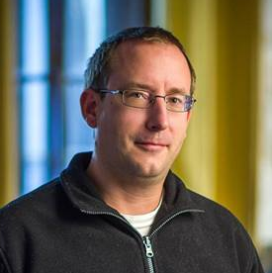
Péter JOLÁNKAI
8th Demo
08.12.2017.
Pallida Cohort - Static Class
Hardware programing

Slide 2
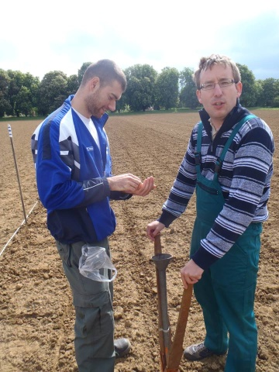
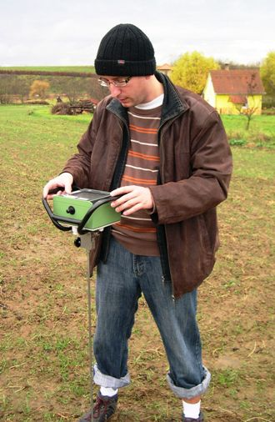

Introduction:
I am an agronomist, with university research
and lecturing background.

Slide 3

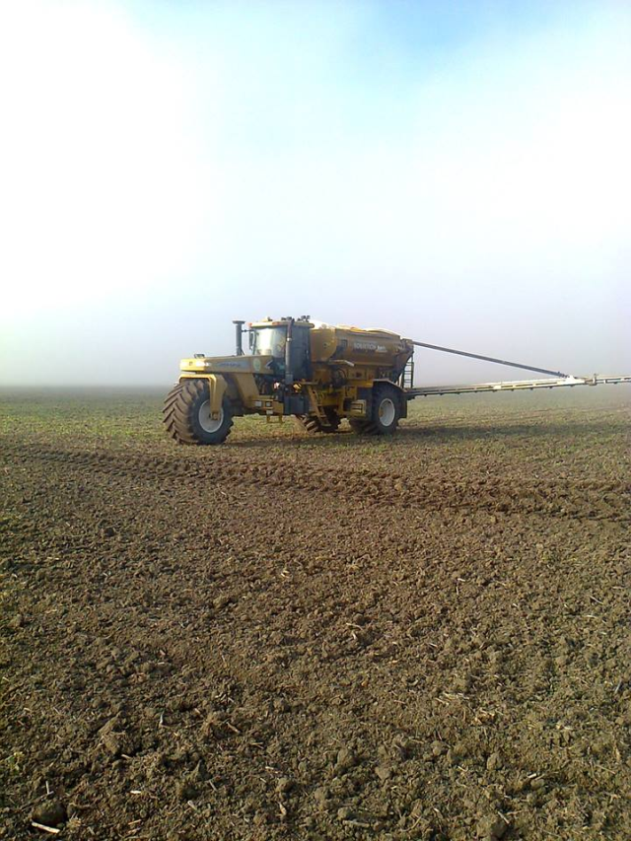
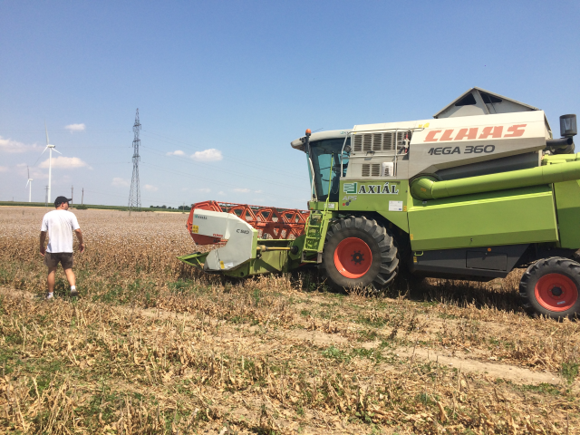
Last I worked for a company as an agronomist for producing medical plants

Slide 4
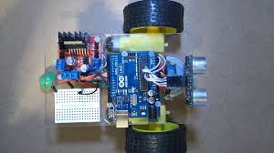
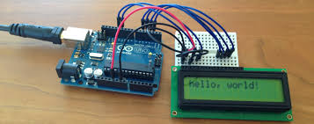
After playing with arduino I decided to join the
hardware programmer course of
Greenfox Academy

Slide 5
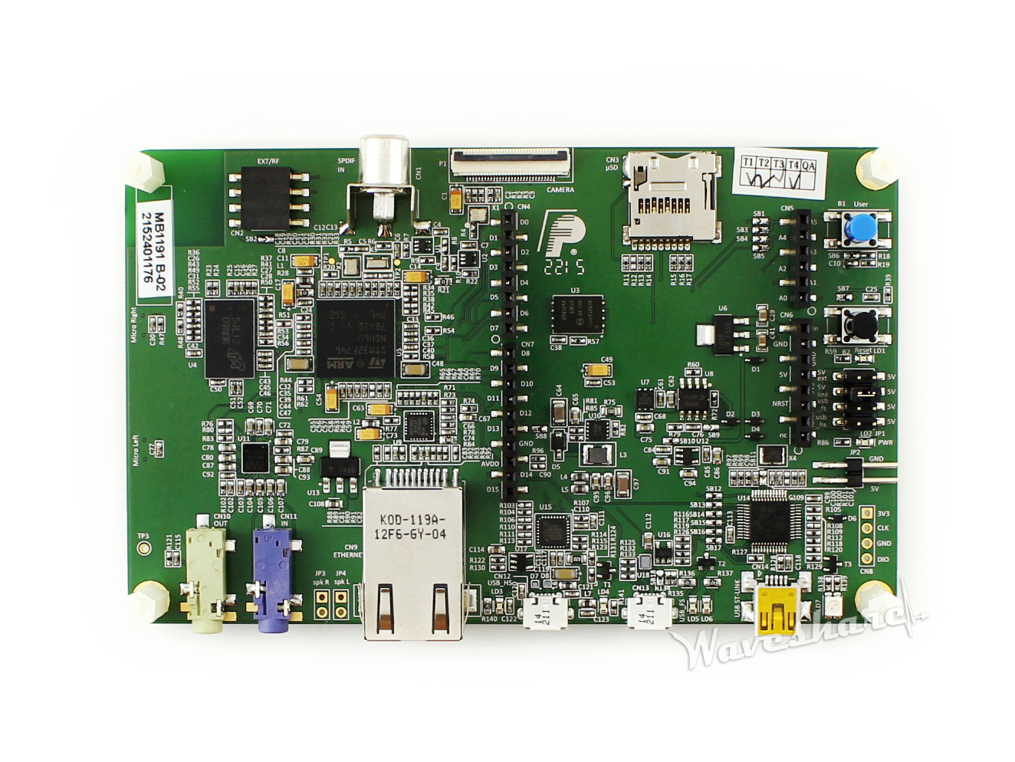
Last week we started work with
STM32746G-Discovery board

Slide 6
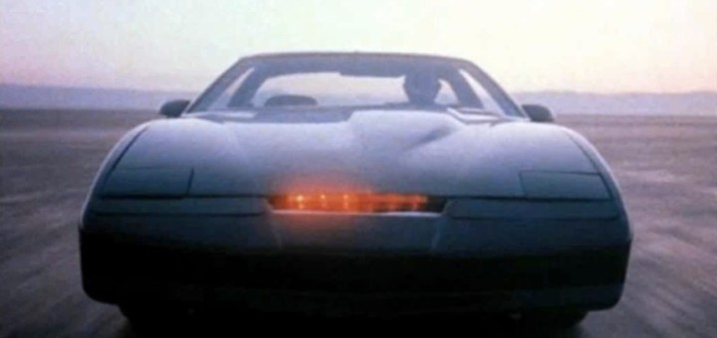
I got one step closer to create a self driving car from my childhood.
Knight Industries Two Thousand

Slide 7
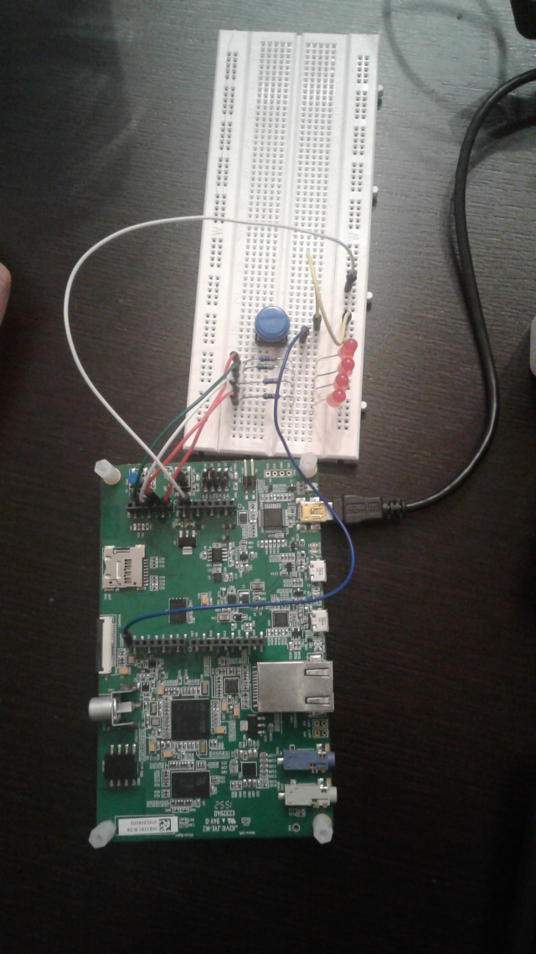

Slide 8
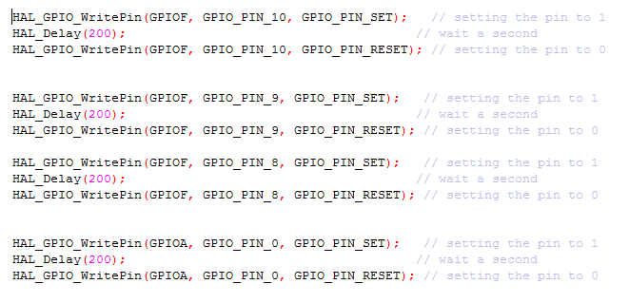
LED lights running

Slide 9
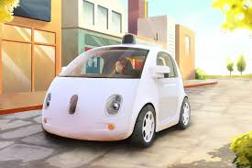
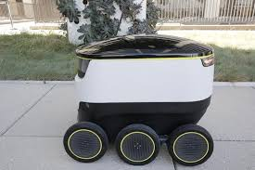
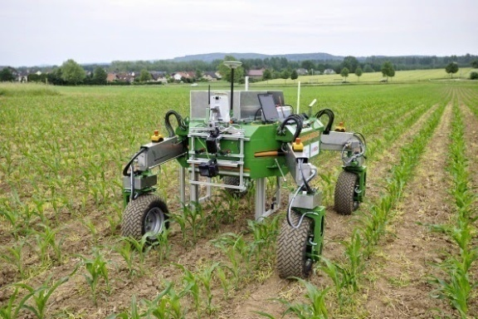
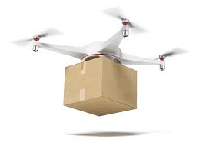
My goal is to learn PLC programming and build
all kind of robots in the future.

Slide 10

Thank you for your attention!

